Slide 1
BST

Slide 2
Insertion
Insert function is used to add a new element in a binary search tree at appropriate location.
Allocate the memory for tree.
Set the data part to the value and set the left and right pointer of tree, point to NULL.
If the item to be inserted, will be the first element of the tree, then the left and right of this node will point to NULL.
Else, check if the item is less than the root element of the tree, if this is true, then recursively perform this operation with the left of the root.
If this is false, then perform this operation recursively with the right sub-tree of the root.

Slide 3
Insert (TREE, ITEM)
Step 1: IF TREE = NULL Allocate memory for TREE SET TREE -> DATA = ITEM SET TREE -> LEFT = TREE -> RIGHT = NULL ELSE IF ITEM < TREE -> DATA Insert(TREE -> LEFT, ITEM) ELSE Insert(TREE -> RIGHT, ITEM) [END OF IF] [END OF IF]
Step 2: END

Slide 4
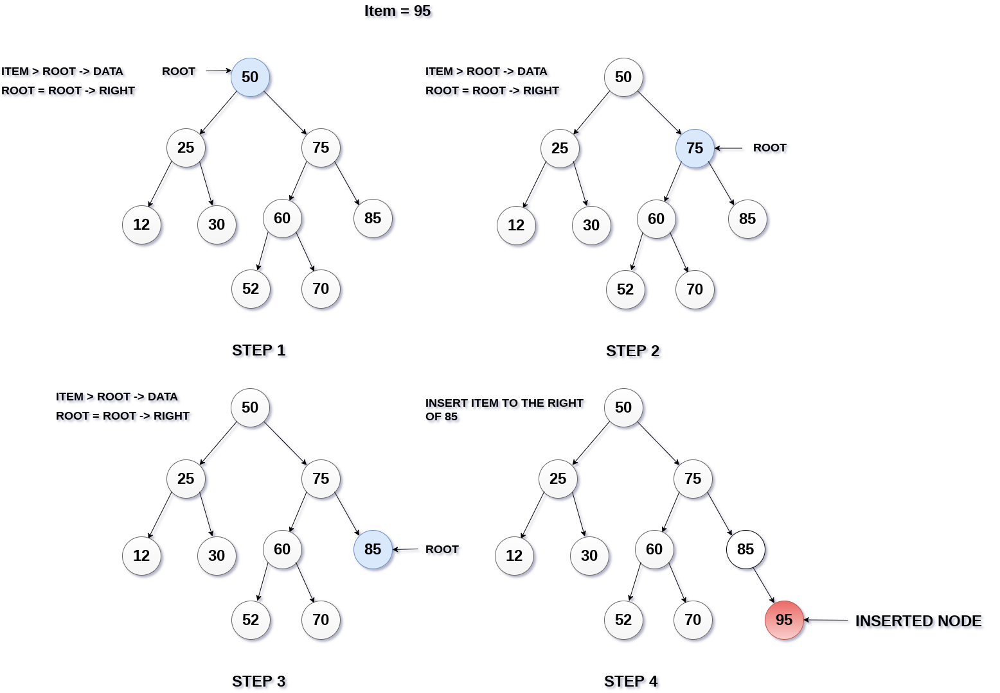

Slide 5
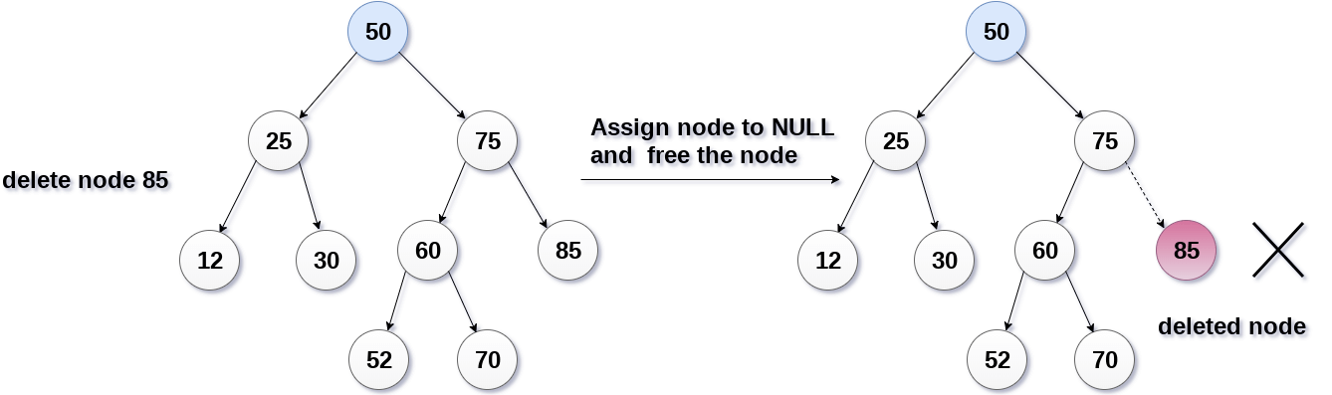
Deletion
The node to be deleted is a leaf node
It is the simplest case, in this case, replace the leaf node with the NULL and simple free the allocated space.
In the following image, we are deleting the node 85, since the node is a leaf node, therefore the node will be replaced with NULL and allocated space will be freed.

Slide 6
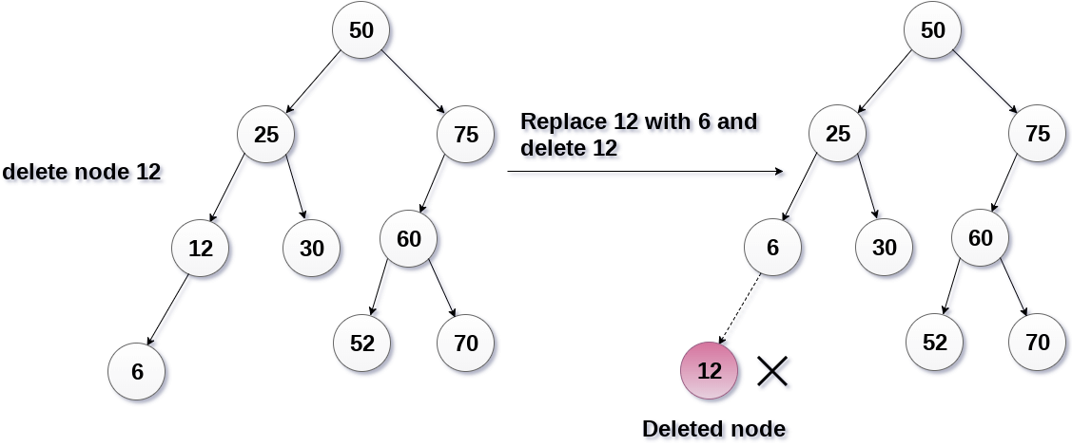
The node to be deleted has only one child.
In this case, replace the node with its child and delete the child node, which now contains the value which is to be deleted. Simply replace it with the NULL and free the allocated space.
In the following image, the node 12 is to be deleted. It has only one child. The node will be replaced with its child node and the replaced node 12 (which is now leaf node) will simply be deleted.

Slide 7
The node to be deleted has two children.
It is a bit complexed case compare to other two cases. However, the node which is to be deleted, is replaced with its in-order successor or predecessor recursively until the node value (to be deleted) is placed on the leaf of the tree. After the procedure, replace the node with NULL and free the allocated space.

Slide 8
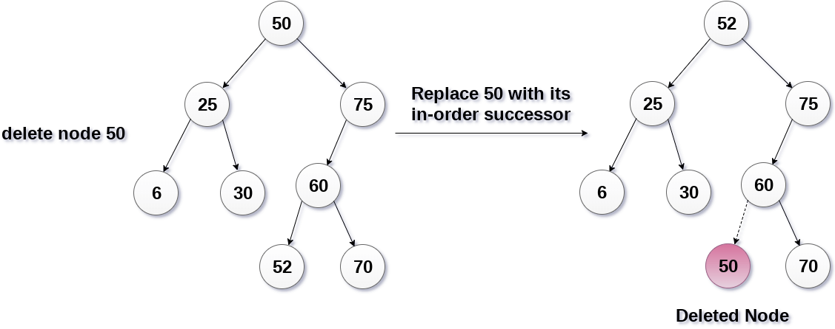
In the following image, the node 50 is to be deleted which is the root node of the tree. The in-order traversal of the tree given below.
6, 25, 30, 50, 52, 60, 70, 75.
replace 50 with its in-order successor 52. Now, 50 will be moved to the leaf of the tree, which will simply be deleted.

Slide 9
Algorithm
Delete (TREE, ITEM)
Step 1: IF TREE = NULL Write "item not found in the tree" ELSE IF ITEM < TREE -> DATA Delete(TREE->LEFT, ITEM) ELSE IF ITEM > TREE -> DATA Delete(TREE -> RIGHT, ITEM) ELSE IF TREE -> LEFT AND TREE -> RIGHT SET TEMP = findLargestNode(TREE -> LEFT) SET TREE -> DATA = TEMP -> DATA Delete(TREE -> LEFT, TEMP -> DATA) ELSE SET TEMP = TREE IF TREE -> LEFT = NULL AND TREE -> RIGHT = NULL SET TREE = NULL ELSE IF TREE -> LEFT != NULL SET TREE = TREE -> LEFT ELSE SET TREE = TREE -> RIGHT [END OF IF] FREE TEMP [END OF IF]
Step 2: END

Slide 10
AVL Tree
AVL Tree is invented by GM Adelson - Velsky and EM Landis in 1962. The tree is named AVL in honour of its inventors.
AVL Tree can be defined as height balanced binary search tree in which each node is associated with a balance factor which is calculated by subtracting the height of its right sub-tree from that of its left sub-tree.
Tree is said to be balanced if balance factor of each node is in between -1 to 1, otherwise, the tree will be unbalanced and need to be balanced.
Balance Factor (k) = height (left(k)) - height (right(k))

Slide 11
Continue. . .
If balance factor of any node is 1, it means that the left sub-tree is one level higher than the right sub-tree.
If balance factor of any node is 0, it means that the left sub-tree and right sub-tree contain equal height.
If balance factor of any node is -1, it means that the left sub-tree is one level lower than the right sub-tree.

Slide 12
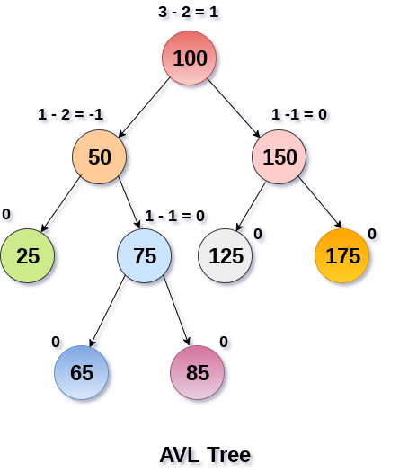
An AVL tree is given in the following figure. We can see that, balance factor associated with each node is in between -1 and +1. therefore, it is an example of AVL tree.

Slide 13
Complexity
Algorithm | Average case | Worst case
Space | o(n) | o(n)
Search | o(log n) | o(log n)
Insert | o(log n) | o(log n)
Delete | o(log n) | o(log n)

Slide 14
Why AVL Tree?
AVL tree controls the height of the binary search tree by not letting it to be skewed. The time taken for all operations in a binary search tree of height h is O(h). However, it can be extended to O(n) if the BST becomes skewed (i.e. worst case). By limiting this height to log n, AVL tree imposes an upper bound on each operation to be O(log n) where n is the number of nodes.

Slide 15
AVL Rotations
We perform rotation in AVL tree only in case if Balance Factor is other than -1, 0, and 1. There are basically four types of rotations which are as follows:
L L rotation: Inserted node is in the left subtree of left subtree of A
R R rotation : Inserted node is in the right subtree of right subtree of A
L R rotation : Inserted node is in the right subtree of left subtree of A
R L rotation : Inserted node is in the left subtree of right subtree of A
Where node A is the node whose balance Factor is other than -1, 0, 1.
The first two rotations LL and RR are single rotations and the next two rotations LR and RL are double rotations. For a tree to be unbalanced, minimum height must be at least 2, Let us understand each rotation

Slide 16
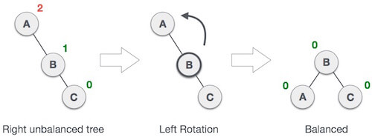
RR Rotation
When BST becomes unbalanced, due to a node is inserted into the right subtree of the right subtree of A, then we perform RR rotation, RR rotation is an anticlockwise rotation, which is applied on the edge below a node having balance factor -2
In example, node A has balance factor -2 because a node C is inserted in the right subtree of A right subtree. We perform the RR rotation on the edge below A.

Slide 17
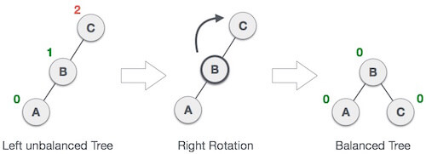
LL Rotation
When BST becomes unbalanced, due to a node is inserted into the left subtree of the left subtree of C, then we perform LL rotation, LL rotation is clockwise rotation, which is applied on the edge below a node having balance factor 2.
In example, node C has balance factor 2 because a node A is inserted in the left subtree of C left subtree. We perform the LL rotation on the edge below A.

Slide 18
LR Rotation
Double rotations are bit tougher than single rotation which has already explained above. LR rotation = RR rotation + LL rotation, i.e., first RR rotation is performed on subtree and then LL rotation is performed on full tree, by full tree we mean the first node from the path of inserted node whose balance factor is other than -1, 0, or 1.

Slide 19

Let us understand each and every step very clearly:
State | Action
 | A node B has been inserted into the right subtree of A the left subtree of C, because of which C has become an unbalanced node having balance factor 2. This case is L R rotation where: Inserted node is in the right subtree of left subtree of C

Slide 20
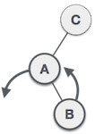
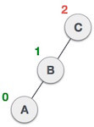
 | As LR rotation = RR + LL rotation, hence RR (anticlockwise) on subtree rooted at A is performed first. By doing RR rotation, node A, has become the left subtree of B.
 | After performing RR rotation, node C is still unbalanced, i.e., having balance factor 2, as inserted node A is in the left of left of C

Slide 21
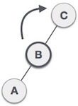
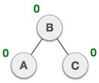
 | Now we perform LL clockwise rotation on full tree, i.e. on node C. node C has now become the right subtree of node B, A is left subtree of B
 | Balance factor of each node is now either -1, 0, or 1, i.e. BST is balanced now.

Slide 22
RL Rotation
As already discussed, that double rotations are bit tougher than single rotation which has already explained above. R L rotation = LL rotation + RR rotation, i.e., first LL rotation is performed on subtree and then RR rotation is performed on full tree, by full tree we mean the first node from the path of inserted node whose balance factor is other than -1, 0, or 1.

Slide 23

State | Action
 | A node B has been inserted into the left subtree of C the right subtree of A, because of which A has become an unbalanced node having balance factor - 2. This case is RL rotation where: Inserted node is in the left subtree of right subtree of A

Slide 24
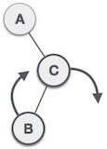
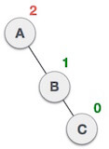
 | As RL rotation = LL rotation + RR rotation, hence, LL (clockwise) on subtree rooted at C is performed first. By doing RR rotation, node C has become the right subtree of B.
 | After performing LL rotation, node A is still unbalanced, i.e. having balance factor -2, which is because of the right-subtree of the right-subtree node A.

Slide 25
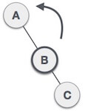
 | Now we perform RR rotation (anticlockwise rotation) on full tree, i.e. on node A. node C has now become the right subtree of node B, and node A has become the left subtree of B.
 | Balance factor of each node is now either -1, 0, or 1, i.e., BST is balanced now.

Slide 26
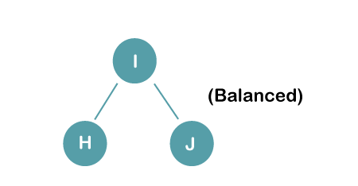
The resultant balance tree is:

Slide 27
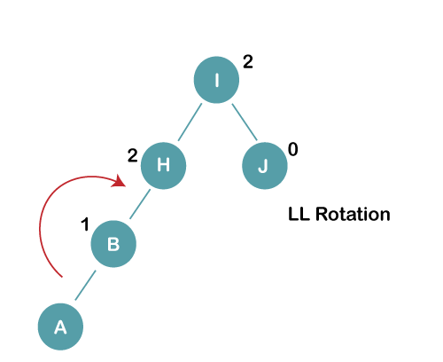
2. Insert B, A
On inserting the above elements, especially in case of A, the BST becomes unbalanced as the Balance Factor of H and I is 2, we consider the first node from the last inserted node i.e. H. Since the BST from H is left-skewed, we will perform LL Rotation on node H.

Slide 28
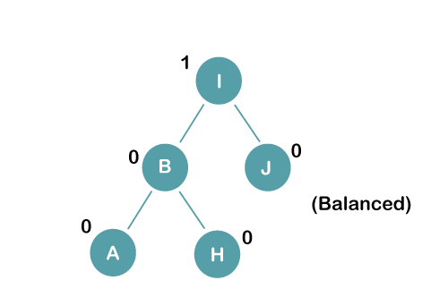
The resultant balance tree is:

Slide 29
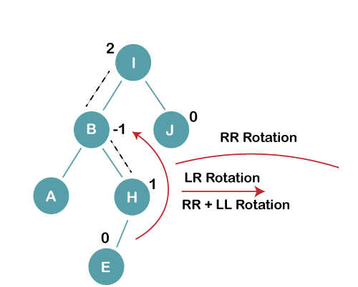
3. Insert E
On inserting E, BST becomes unbalanced as the Balance Factor of I is 2, since if we travel from E to I we find that it is inserted in the left subtree of right subtree of I, we will perform LR Rotation on node I. LR = RR + LL rotation

Slide 30
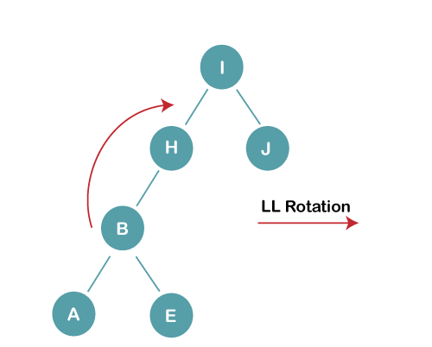
3 a) We first perform RR rotation on node B
The resultant tree after RR rotation is:

Slide 31
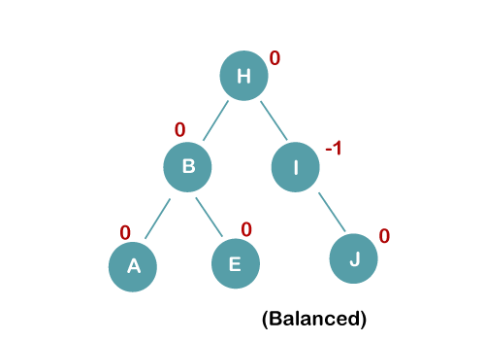
3b) We first perform LL rotation on the node I
The resultant balanced tree after LL rotation is:

